Slide 1


Clustering
K-means
LC135

Slide 2
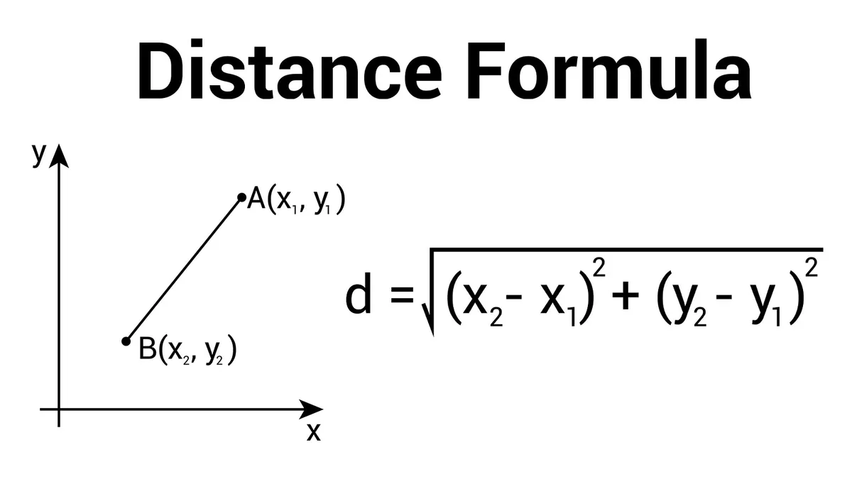
Similarity Measurement
The similarity between two objects.
Euclidean distance

Slide 3
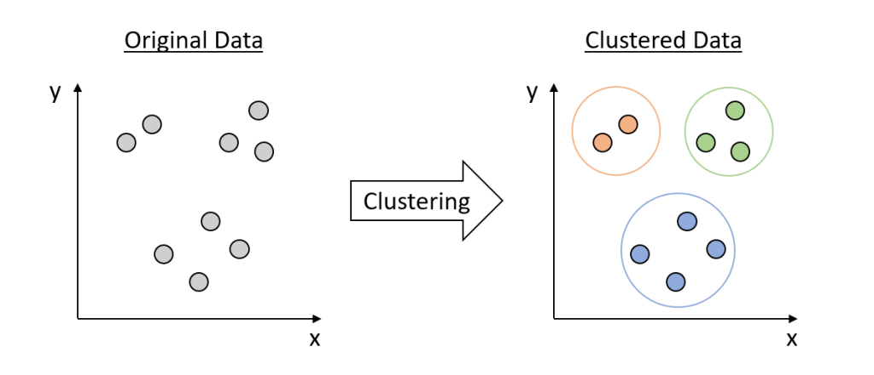
Grouping a set of objects in such a way that objects in the same group are more similar to each other than to those in other groups.

Slide 4
ID | Sepal Length | Sepal Width | Petal Length | Petal Width
id_36 | 5.0 | 3.2 | 1.2 | 0.2
id_46 | 4.8 | 3.0 | 1.4 | 0.3
id_86 | 6.0 | 3.4 | 4.5 | 1.6
id_96 | 5.7 | 3.0 | 4.2 | 1.2
id_136 | 7.7 | 3.0 | 6.1 | 2.3

Slide 5
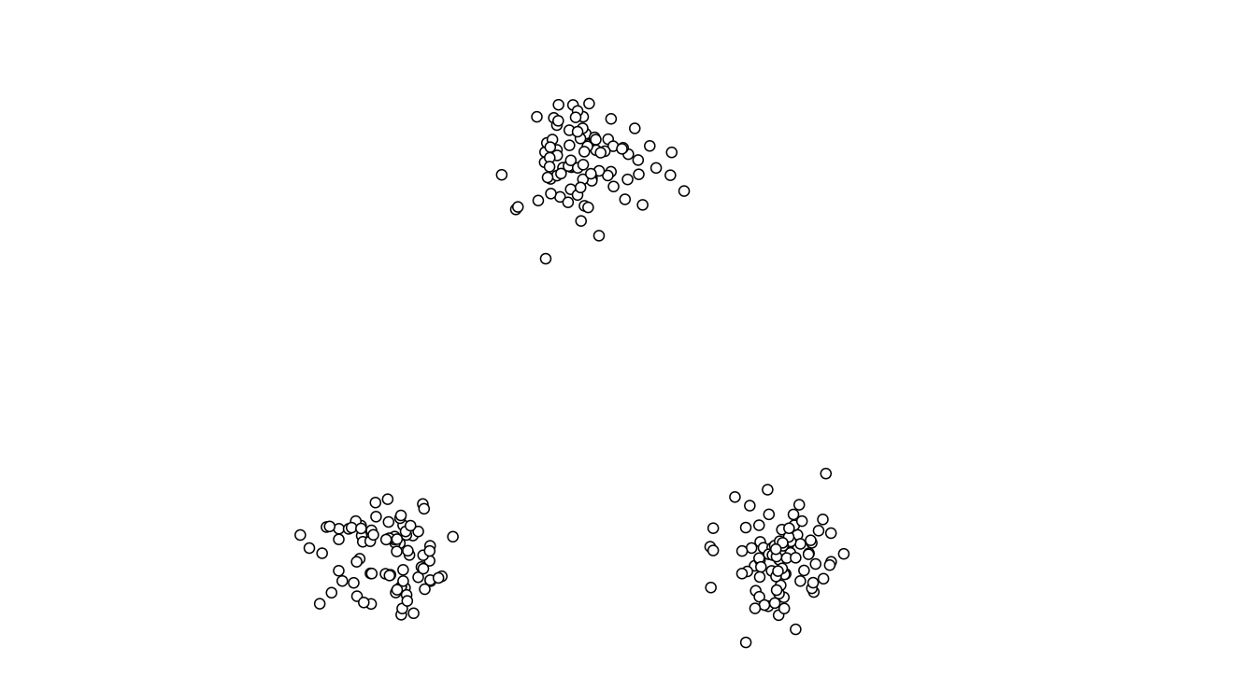
https://www.naftaliharris.com/blog/visualizing-k-means-clustering/

Slide 6
Step 1
Choose the number of clusters (k): Decide how many clusters you want to identify in your data
Initialize centroids: Randomly select k initial points from the dataset as the starting centroids for each cluster.

Slide 7
ID | Sepal Length | Sepal Width | Petal Length | Petal Width
id_36 | 5.0 | 3.2 | 1.2 | 0.2
id_46 | 4.8 | 3.0 | 1.4 | 0.3
id_86 | 6.0 | 3.4 | 4.5 | 1.6
id_96 | 5.7 | 3.0 | 4.2 | 1.2
id_136 | 7.7 | 3.0 | 6.1 | 2.3

Slide 8
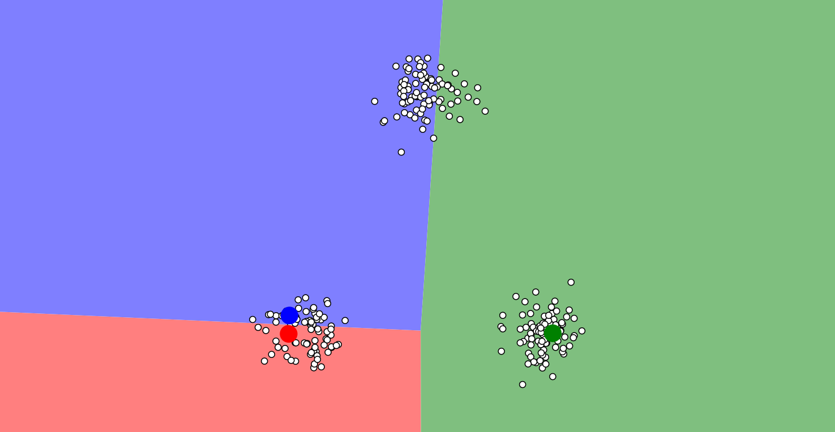

Slide 9
Step 2
For each data point, calculate the Euclidean distance to each centroid.

Slide 11
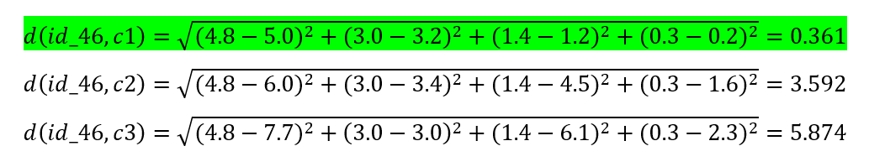
ID | Sepal Length | Sepal Width | Petal Length | Petal Width
id_36 (c1) | 5.0 | 3.2 | 1.2 | 0.2
id_46 | 4.8 | 3.0 | 1.4 | 0.3
id_86 (c2) | 6.0 | 3.4 | 4.5 | 1.6
id_136 (c3) | 7.7 | 3.0 | 6.1 | 2.3

Slide 12
Assign each data point to the cluster of the nearest centroid.
C1

Slide 14
C2

Slide 15
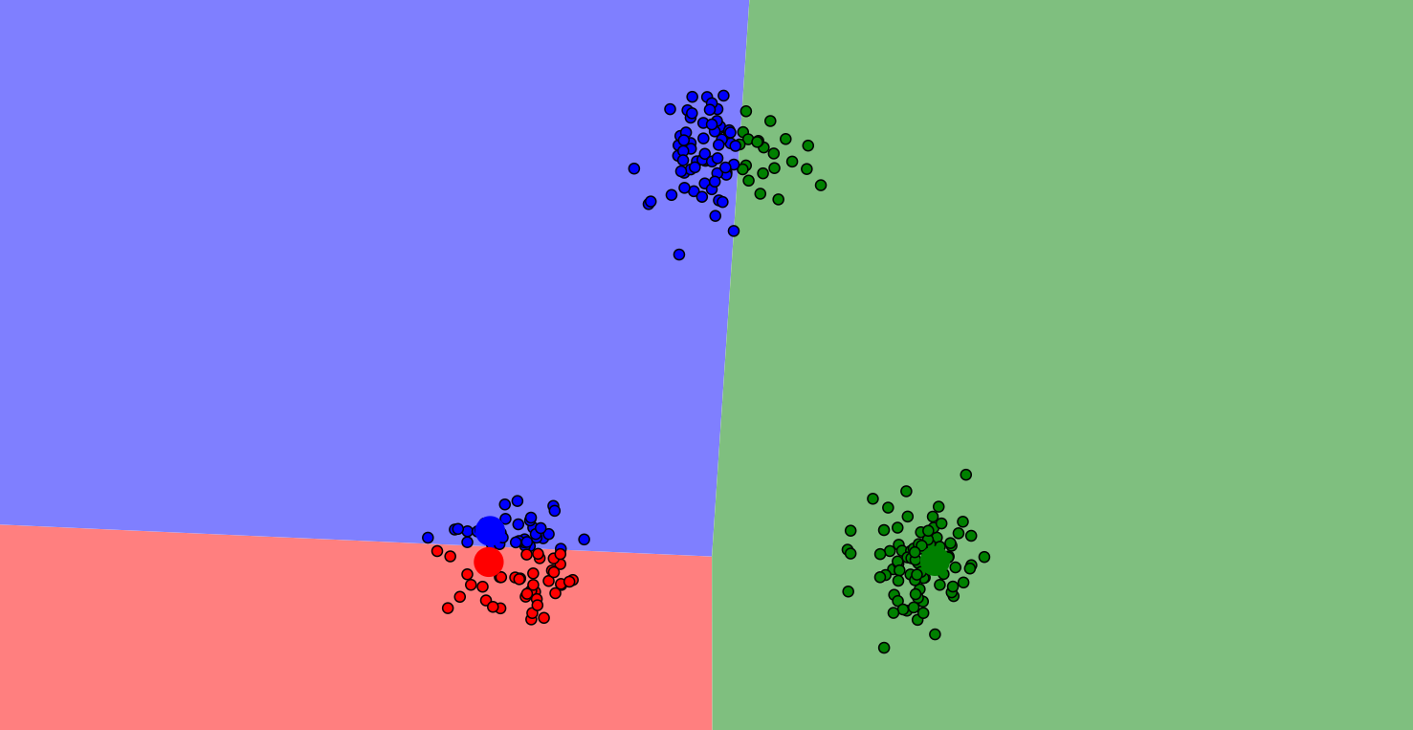

Slide 16
Step 3
For each cluster, recalculate the centroid by finding the mean of all points assigned to that cluster.

Slide 17
ID | Sepal Length | Sepal Width | Petal Length | Petal Width
id_36 (c1) | 5.0 | 3.2 | 1.2 | 0.2
id_46 (c1) | 4.8 | 3.0 | 1.4 | 0.3
id_86 (c2) | 6.0 | 3.4 | 4.5 | 1.6
id_96 (c2) | 5.7 | 3.0 | 4.2 | 1.2
id_136 (c3) | 7.7 | 3.0 | 6.1 | 2.3

Slide 18
ID | Sepal Length | Sepal Width | Petal Length | Petal Width
id_36 (c1) | 5.0 | 3.2 | 1.2 | 0.2
id_46 (c1) | 4.8 | 3.0 | 1.4 | 0.3
Cluster | Sepal Length | Sepal Width | Petal Length | Petal Width
C1 | = (5.0 + 4.8) / 2 = 4.9 | = (3.2 + 3.0) / 2 = 3.1 | = (1.2 + 1. 4) / 2 = 1.3 | = (0.2 + 0.3) / 2 = 0.25

Slide 19
Cluster | Sepal Length | Sepal Width | Petal Length | Petal Width
C1 | = (5.0 + 4.8) / 2 = 4.9 | = (3.2 + 3.0) / 2 = 3.1 | = (1.2 + 1. 4) / 2 = 1.3 | = (0.2 + 0.3) / 2 = 0.25
C2 | = (6.0 + 5.7) / 2 = 5.85 | = (3.4 + 3.0) / 2 = 3.2 | = (4.5 + 4.2) / 2 = 4.35 | = (1.6 + 1.2) / 2 = 1.4
C3 | = 7.7 | = 3.0 | = 6.1 | = 2.3

Slide 20
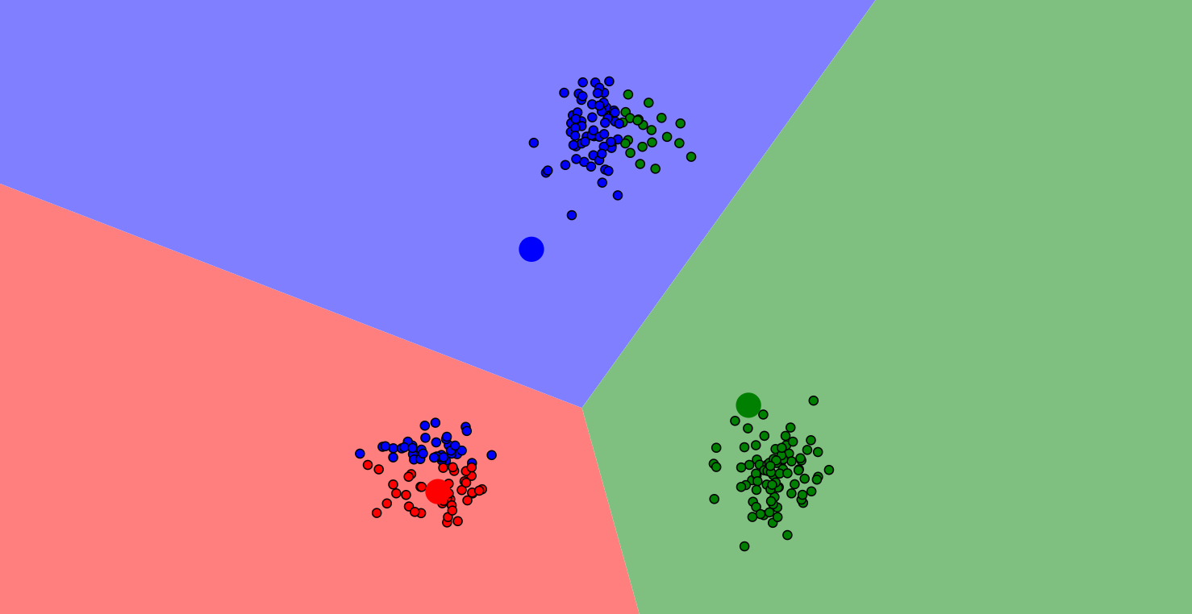

Slide 21
Step 4
For each data point, calculate the Euclidean distance to the new centroid.
Assign each data point to the cluster of the nearest centroid.

Slide 22
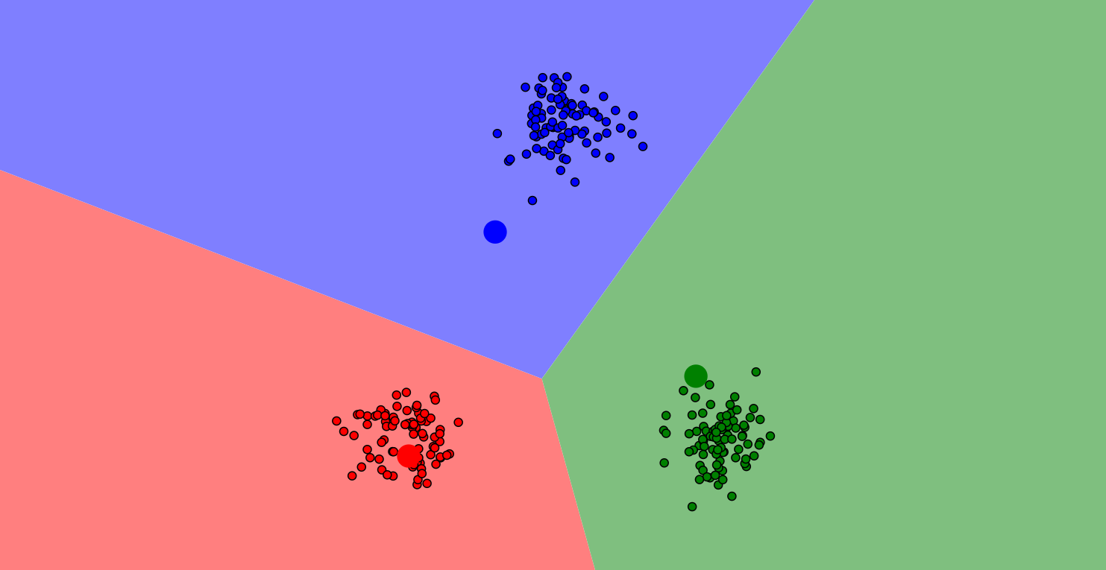

Slide 23
Step 5
Repeat the process until the centroids no longer change significantly or a maximum number of iterations is reached

Slide 24
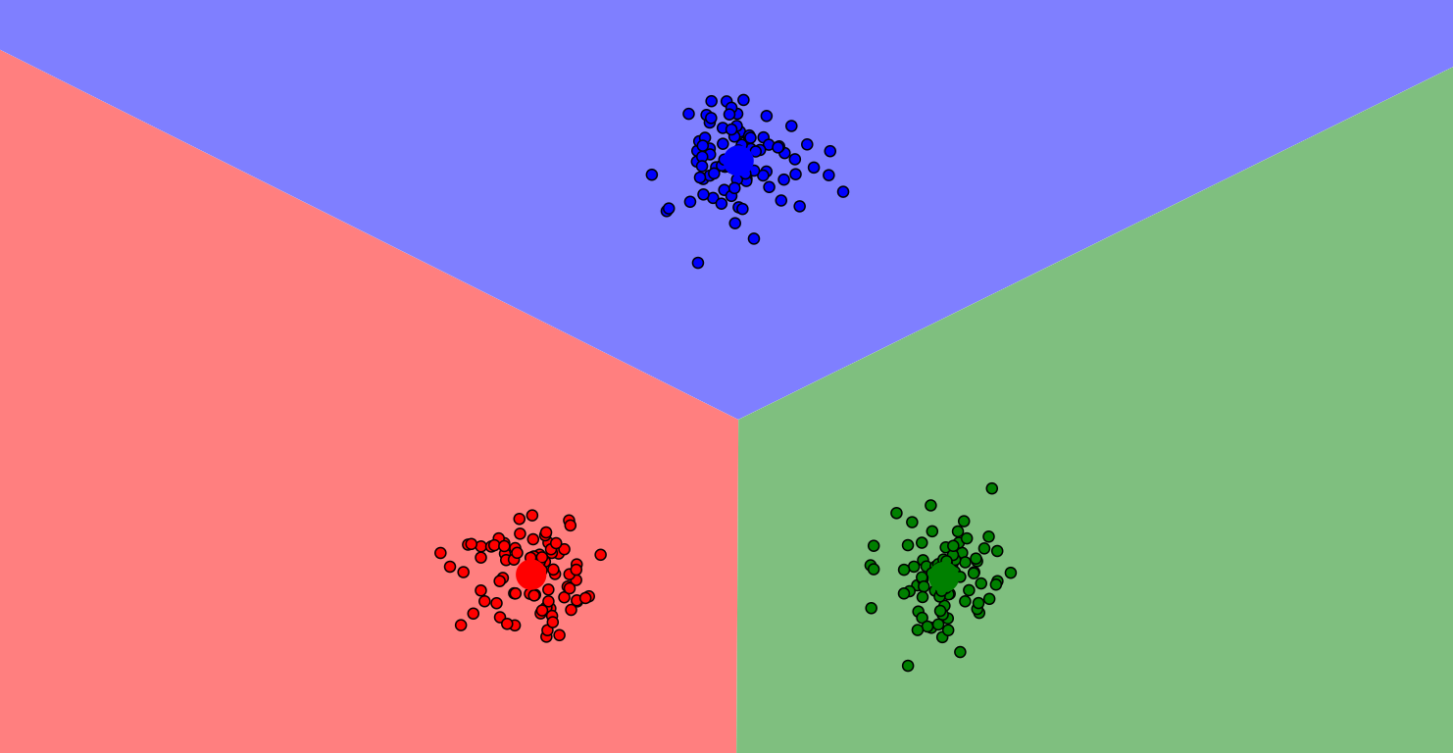

Slide 25
Cluster | Sepal Length | Sepal Width | Petal Length | Petal Width
C1 | 4.9 | 3.1 | 1.3 | 0.25
C2 | 5.85 | 3.2 | 4.35 | 1.4
C3 | 7.7 | 3.0 | 6.1 | 2.3

Slide 26
Cluster | Sepal Length | Sepal Width | Petal Length | Petal Width
Flower A | medium | medium | short | short
Flower B | medium | medium | medium | medium
Flower C | long | medium | long | long

Slide 27
ID | Sepal Length | Sepal Width | Petal Length | Petal Width | Cluster
id_36 | 5.0 | 3.2 | 1.2 | 0.2 | C1
id_46 | 4.8 | 3.0 | 1.4 | 0.3 | C1
id_86 | 6.0 | 3.4 | 4.5 | 1.6 | C2
id_96 | 5.7 | 3.0 | 4.2 | 1.2 | C2
id_136 | 7.7 | 3.0 | 6.1 | 2.3 | C3

Slide 28
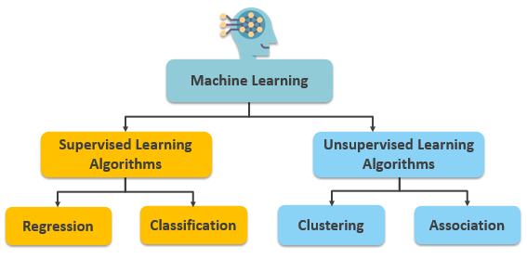

Slide 29
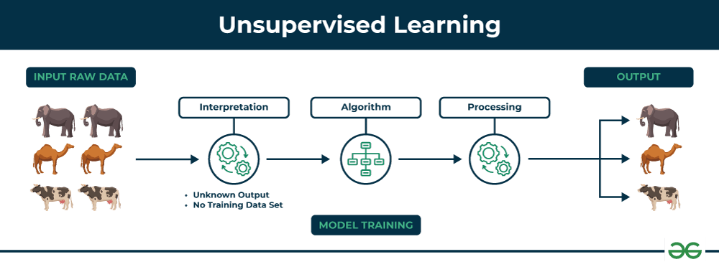

Slide 30
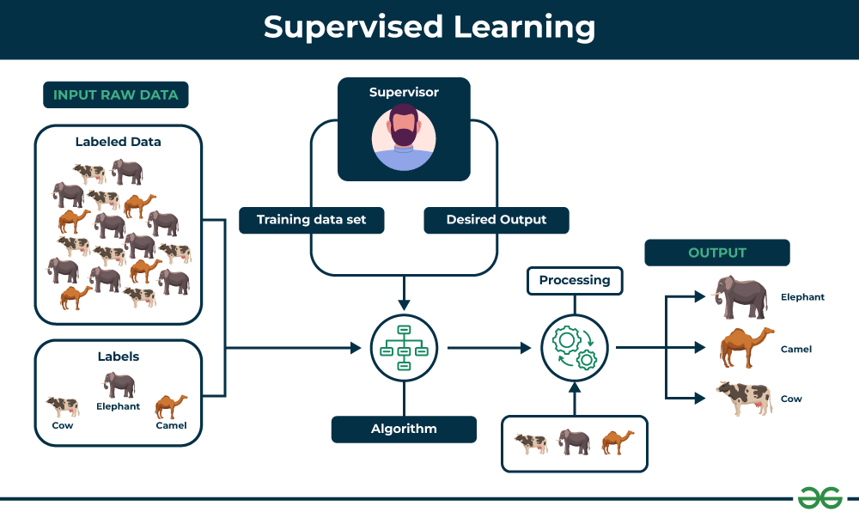

Slide 31
ID | Sepal Length | Sepal Width | Petal Length | Petal Width | Type
id_36 | 5.0 | 3.2 | 1.2 | 0.2 | Flower A
id_46 | 4.8 | 3.0 | 1.4 | 0.3 | Flower A
id_86 | 6.0 | 3.4 | 4.5 | 1.6 | Flower B
id_96 | 5.7 | 3.0 | 4.2 | 1.2 | Flower B
id_136 | 7.7 | 3.0 | 6.1 | 2.3 | Flower C

Slide 32
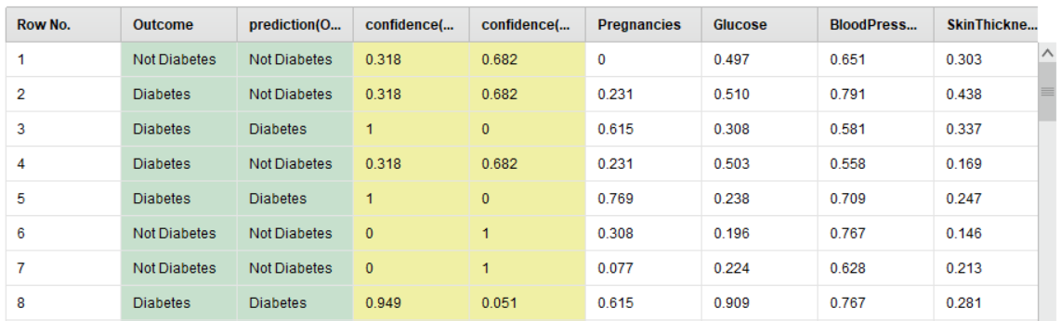
Classification

Slide 33

Rapid Miner
Documentation
https://docs.rapidminer.com/2024.1/studio/operators/modeling/segmentation/k_means.html

